Slide 1
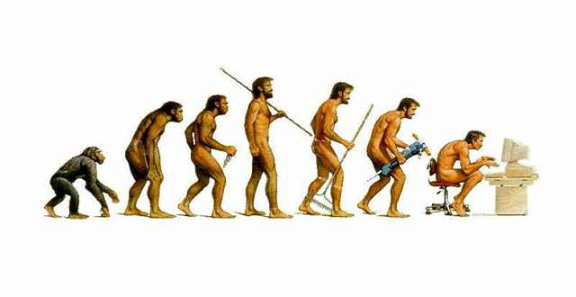
Software Evolution

Slide 2
Software change
Software change is inevitable
A key problem is implementing and managing change to existing software systems.

Slide 3

Importance of evolution
Organizations have huge investments in their software systems
Must be changed and updated to maintain value.
The majority of the software budgets are devoted to changing and evolving existing software.

Slide 4
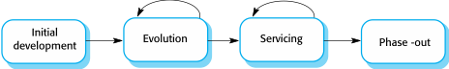
Evolution and servicing
Evolution: System is in use and is evolving as new requirements are proposed and implemented.
Servicing: Software remains useful but the only changes made are those required to keep it operational. No new functionality is added.
Phase-out: Software may still be used but no further changes are made to it.

Slide 5
Evolution processes
Software evolution processes varies
Proposals for change are the driver for system evolution.
Change identification and evolution continues throughout the system lifetime.

Slide 6
Change implementation
Revisions to the system are designed, implemented and tested.
May involve a program understanding phase

Slide 7
Urgent change requests
Urgent changes may have to be implemented without going through all stages of the software engineering process.

Slide 8
Quiz Question 1
Why is studying software evolution important?
The majority of the software budget in large companies is devoted to changing and evolving existing software.
Software only needs to change in extreme situations.
Errors must be repaired
The performance or reliability of the system may have to be improved
Notes:
The majority of the software budget in large companies is devoted to changing and evolving existing software.

Slide 9
Quiz Question 2
Why is software change is inevitable?
New requirements emerge when the software is used.
The business environment is static.
Changing software is so inexpensive it can be done frequently.
Dr. Howard says so.
Notes:
New requirements emerge when software is used

Slide 10
Quiz Question 3
How is change implementation different than new product implementation?
Change implementation does not require design or testing.
It's always a lot harder
The first stage of new product implementation usually involves program understanding
Original system developers are not responsible for the change implementation.
Notes:
The first stage usually involves program understanding

Slide 11
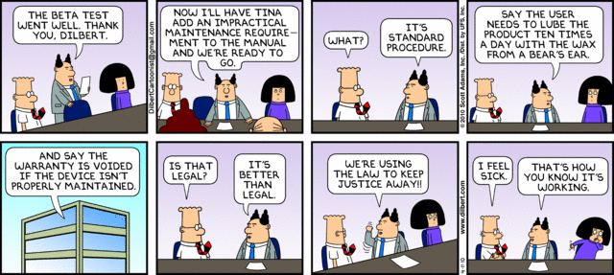
Software Maintenance
Date

Slide 12
Software maintenance
Modifying a program after it has been put into use.
Maintenance does not normally involve major changes to the system’s architecture.
Changes are implemented by modifying existing components and adding new components to the system.

Slide 13
Maintenance is not bug fixes
Enhancements: 60% of maintenance costs
Bug fixes: 17% of maintenance costs
Hence the 60/60 rule:
60% of software cost is maintenance
60% of maintenance cost is enhancements.
Glass, R. Software Conflict. Englewood Cliffs, NJ: Yourdon Press, 1991

Slide 14
Types of maintenance
Maintenance to repair software faults
Maintenance to adapt software to a different operating environment
Maintenance to add to or modify the system’s functionality

Slide 15
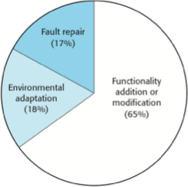
Maintenance effort distribution

Slide 16
Maintenance costs
Usually greater than development costs
Affected by both technical and non-technical factors.
Increases as software is maintained.

Slide 17
Maintenance cost factors
Team stability
Contractual responsibility
Staff skills
Program age and structure

Slide 18
Quiz Question 4
Which of the following is false?
Maintenance involves making changes by modifying existing components and adding new components to the system.
Maintenance is modifying a program after it has been put into use.
Maintenance does not normally involve major changes to the system’s architecture.
Maintenance is mostly used for packaged software products.
Notes:
D.

Slide 19
Quiz Question 5
In which area does most maintenance effort occur?
Fault repair
Operating system changes
Additional functionality
Notes:
C.

Slide 20
Quiz Question 6
Why do maintenance costs increase as software as maintained?
Aging software may use outdated technologies
Older software may contain more complex interfaces.
Maintenance corrupts the software structure which makes further maintenance more difficult.
All of the above.
Notes:
D

Slide 21
System Re-Engineering
Date

Slide 22
System re-engineering
Re-structuring or re-writing part or all of a system without changing its functionality.
Involves adding effort to make a system easier to maintain.

Slide 23
Advantages of reengineering
Reduced risk
Reduced cost

Slide 24
Re-engineering process activities
Source code translation
Reverse engineering
Program structure improvement
Program modularization
Data re-engineering

Slide 25
Reengineering cost factors
The quality of the software to be reengineered.
The tool support available for reengineering.
The extent of the data conversion which is required.
The availability of expert staff for reengineering.

Slide 26
Refactoring
Date

Slide 27
Preventative maintenance by refactoring
The process of making improvements to a program to slow down degradation through change.
Modifying a program to improve its structure, reduce its complexity or make it easier to understand.

Slide 28
Refactoring VS. Re-engineering
Re-engineering takes place after a system has been maintained for some time and maintenance costs are increasing
Refactoring is a continuous process of improvement throughout the development and evolution process.

Slide 29
Potential problems in program code
Duplicate code
Long methods
Switch (case) statements
Data clumping
Speculative generality

Slide 30
Quiz Question 7
The process of making improvements to a program to slow down degradation through change is called
Re-engineering
Refactoring
Notes:
refactoring

Slide 31
Quiz Question 8
Both re-engineering and refactoring involve adding functionality
True. Both involve adding functionality.
Only re-engineering involves adding functionality
Only refactoring involves adding functionality
Neither involves adding functionality
Notes:
neither involves adding functionality

Slide 32
Quiz Question 9
Which of the following are potential problems in code that can be corrected through refactoring?
Duplicate code
Switch statements
Speculative generality
A and B
A, B and C
Notes:
All of the above

Slide 33
Legacy Systems
Date

Slide 34
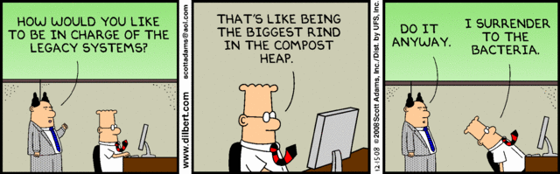
Legacy Systems
Legacy systems are systems that are still useful and are sometimes critical to business operations
It may not be cost effective to replace these systems

Slide 35
Legacy system management
Strategies
Scrap the system
Continue maintaining
Re-engineer
Replace
The strategy chosen should depend on the system quality and its business value.

Slide 36
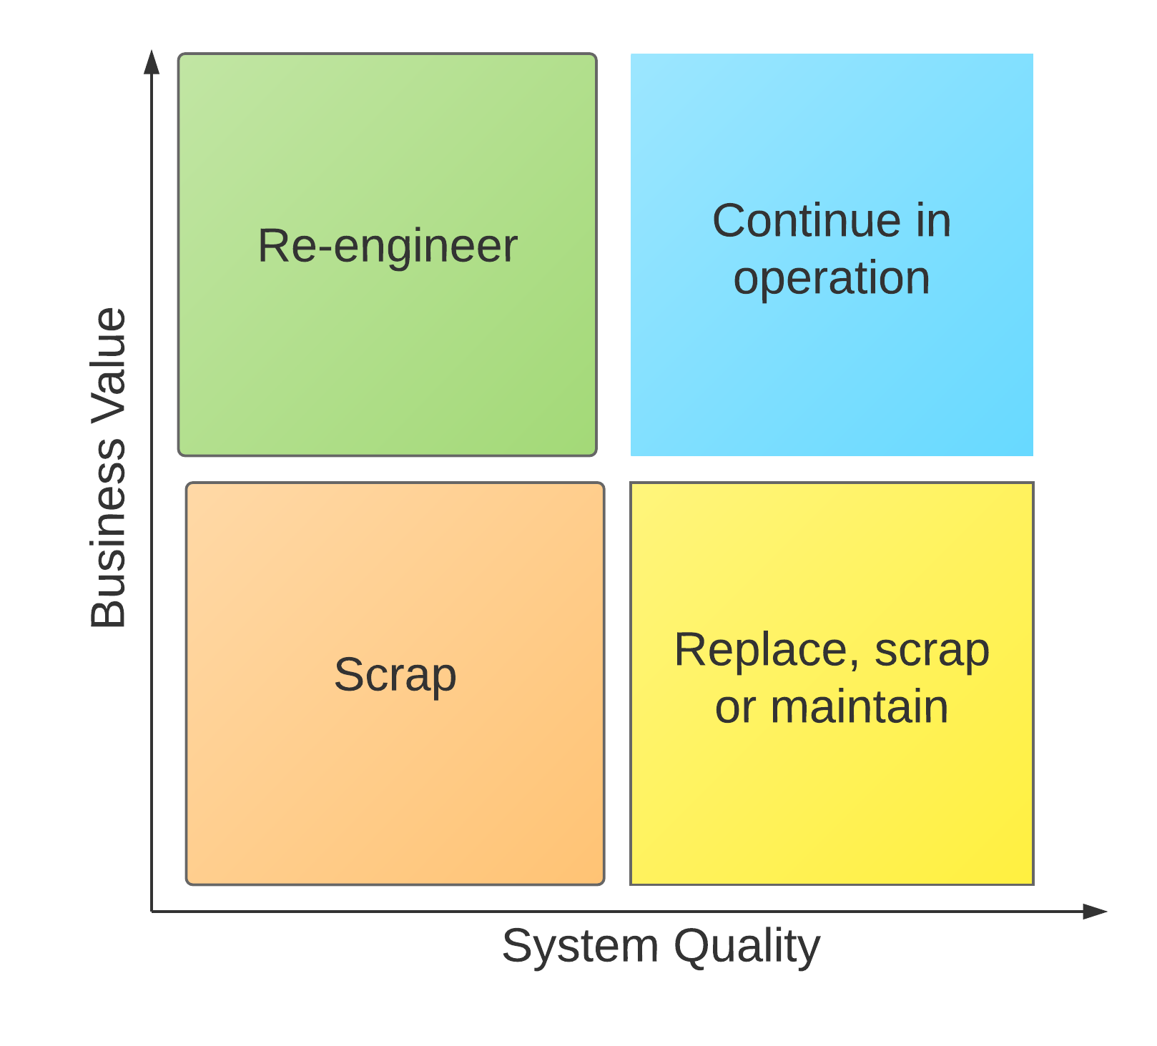
Legacy System Categories

Slide 37
Business value assessment
Assessment should take different viewpoints into account
Interview different stakeholders and collate results.

Slide 38
Issues in business value assessment
The use of the system
The business processes that are supported
System dependability
The system outputs

Slide 39
System quality assessment
Business process assessment
Environment assessment
Application assessment

Slide 40
Quality measurement
Can collect quantitative data to make an assessment of the quality of the application system.

Slide 41
Quiz Question 10
Some legacy systems can continue in normal operation using normal system maintenance
True
False
Notes:
true

Slide 42
Quiz Question 11
For which type of legacy systems is scrapping the only option?
Low quality, low business value
Low quality, high business value
High quality, low business value
High quality, high business value
Notes:
A - low quality, low business value

Slide 43
Quiz Question 12
Which of the following should be considered in determining the business value of a system?
Varying viewpoints
The number of users of the system.
The dependability of the system.
B and C
A, B and C
Notes:
all of the above

